Slide 1
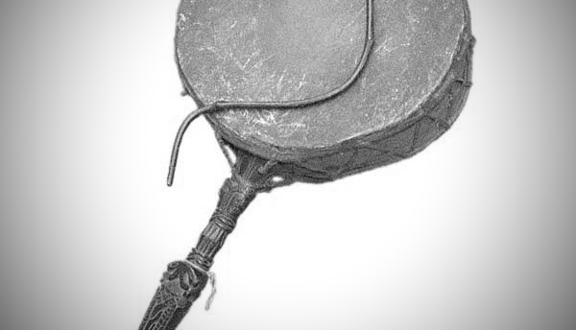
PROJECT
DHYANGRO
AN INITIATIVE TO PRESERVE AND PROMOTE NEPALI MUSICAL INSTRUMENTS

Slide 2
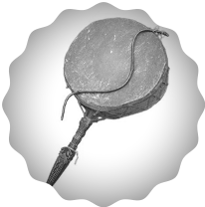

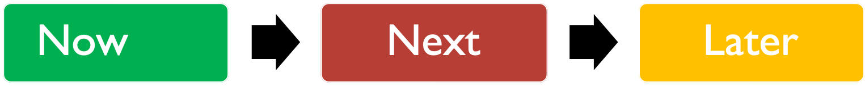
Reaching Out
Contact music enthusiasts to form a group of like-minded vision
Collect Samples
Collect samples of the instrument recordings from contact group
Upload Samples
Raw samples upload to online repository
Outreach
Inform public of available samples
Collect Samples II & Upload
Clean Samples
Process Samples for MIDI
Prepare for MIDI
Resource acquisition, invite collaborators, manage access
Create MIDI Inputs
MIDI input for all instrument samples
Create User Friendly Interface
Release & Feasibility of Next Release
Further Applications
Investigate applications of Dhyangro to other complimentary project branching

Slide 3

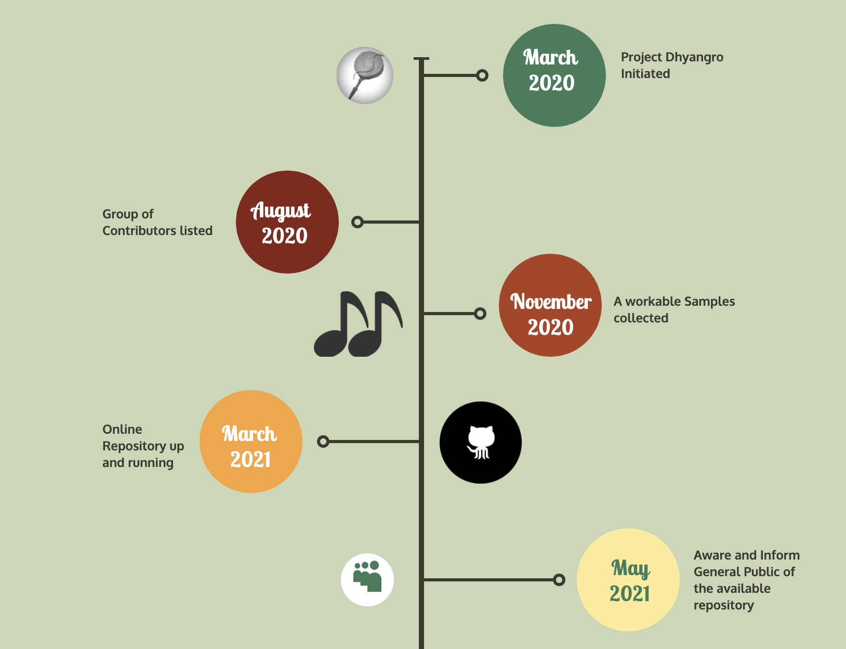

Slide 4
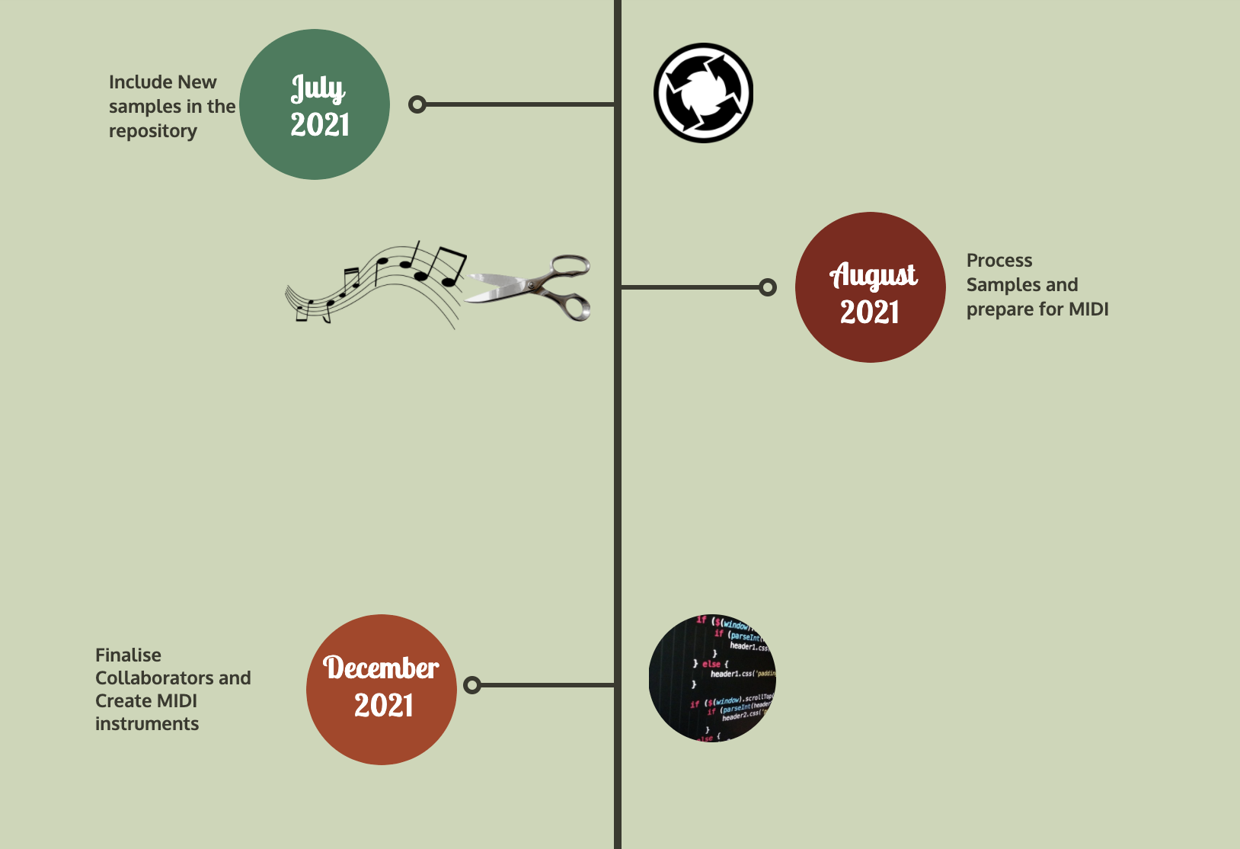

Slide 5

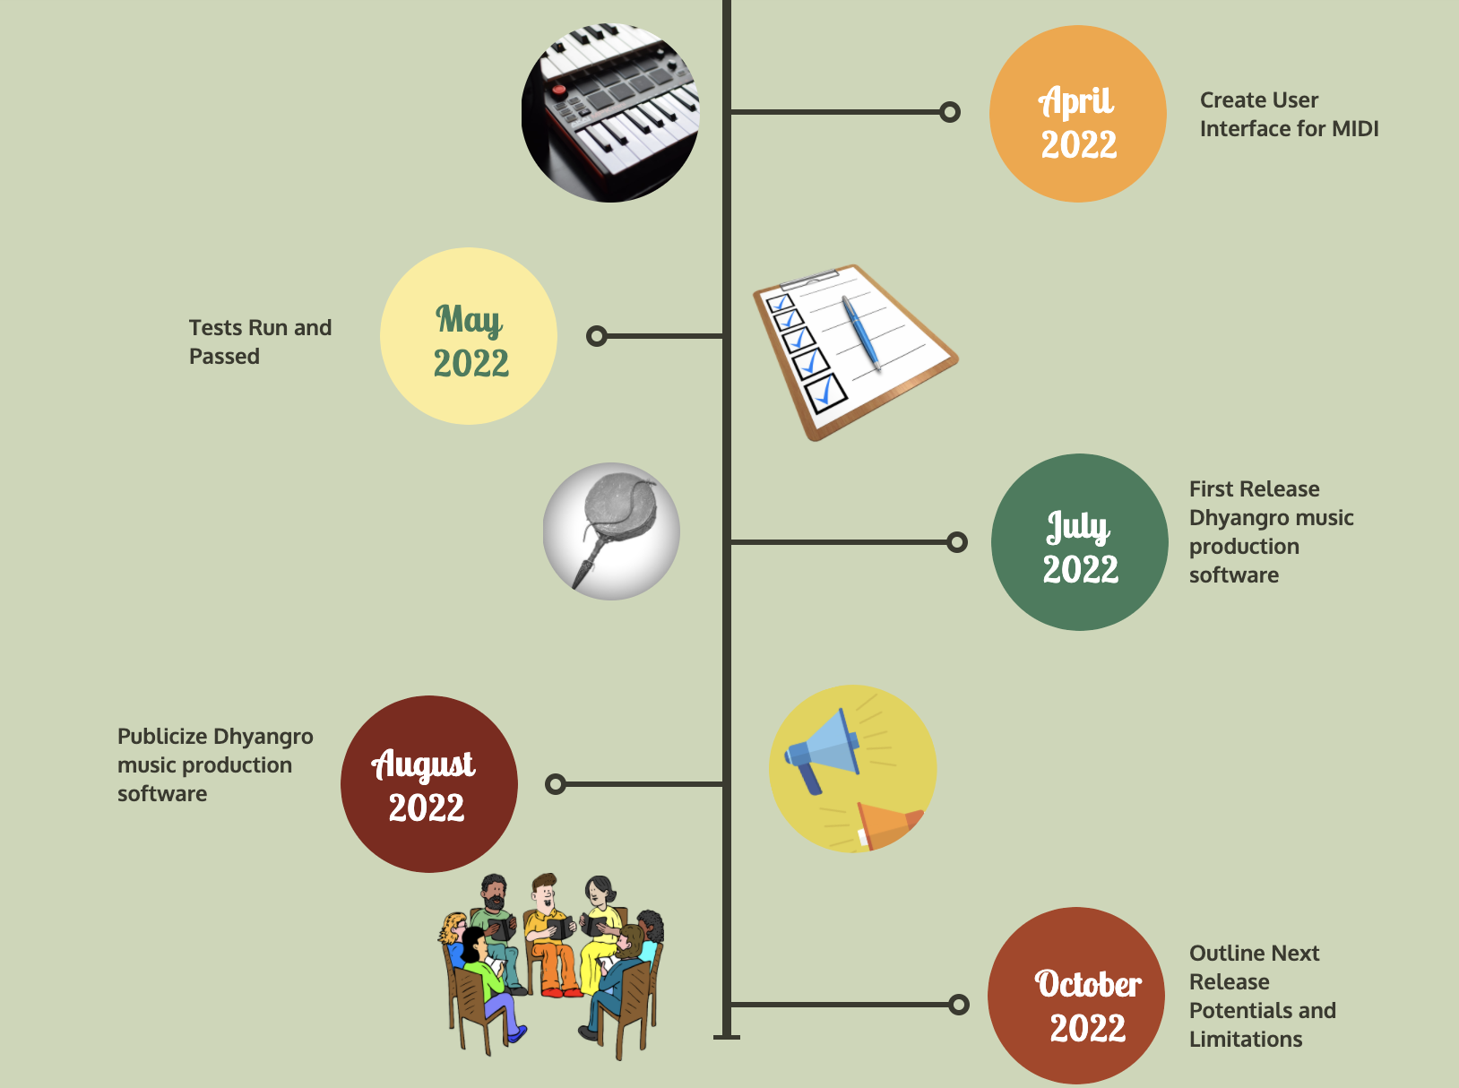

Slide 6
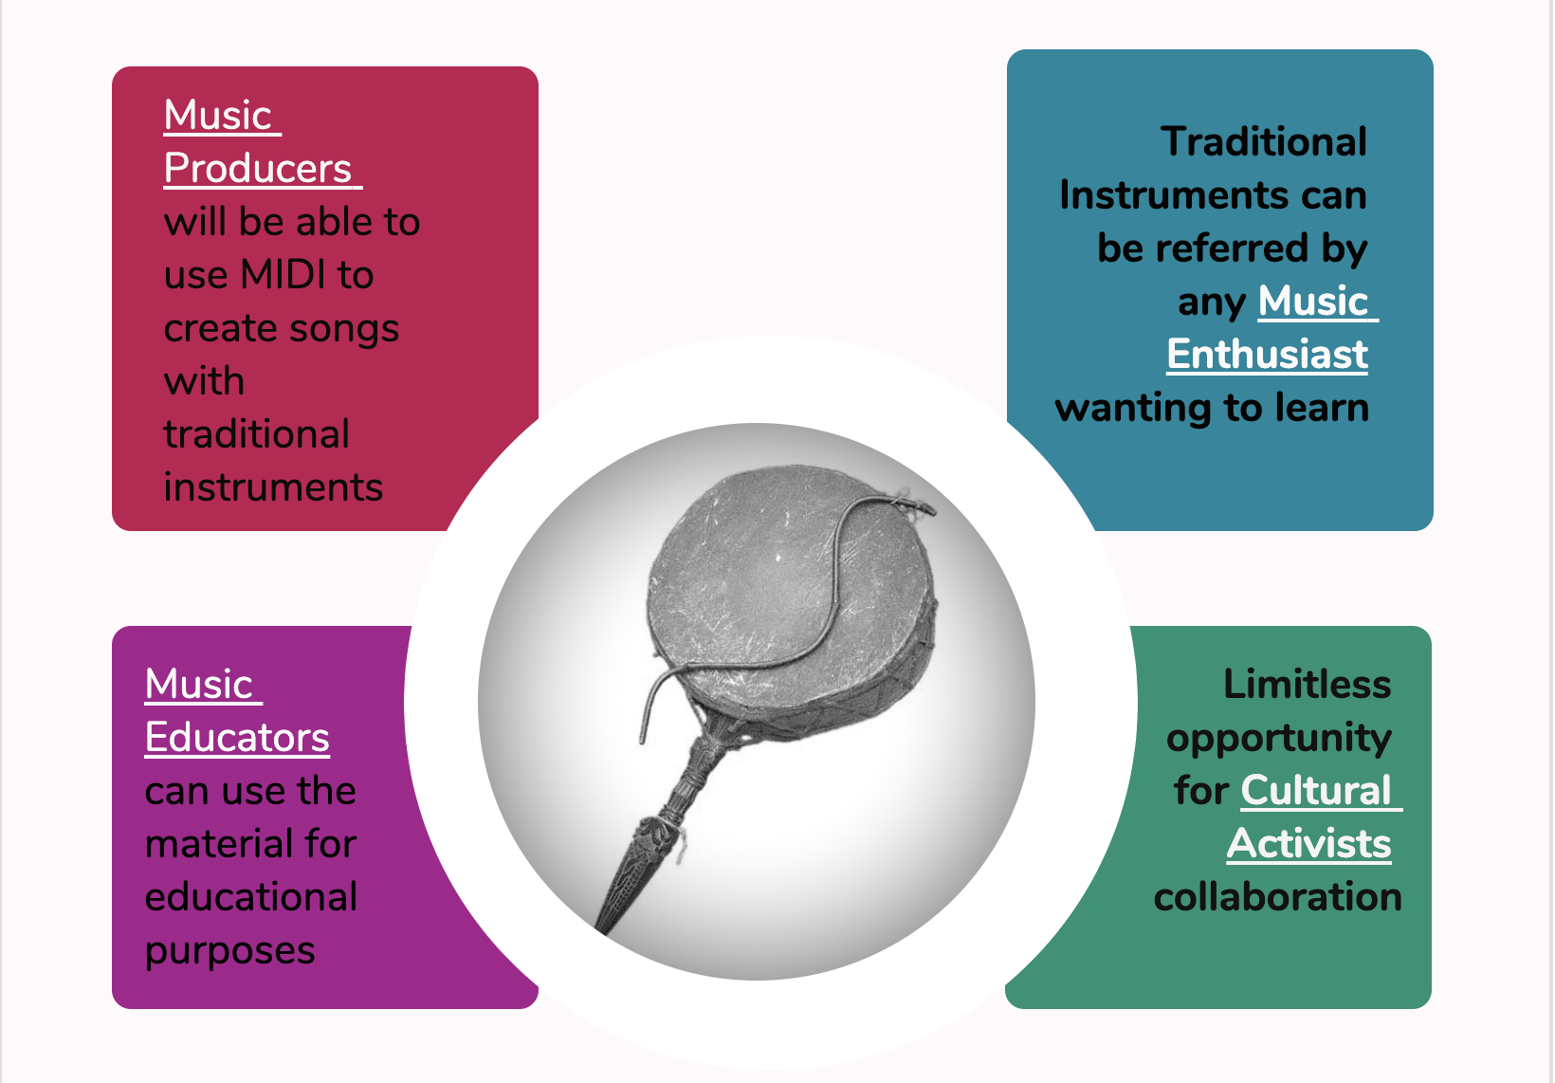

Slide 7
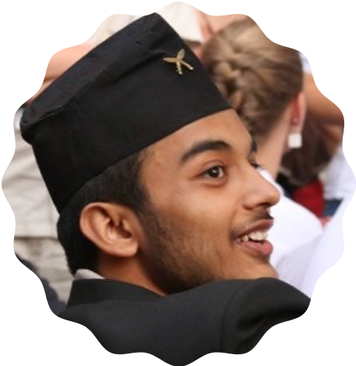
JOIN THE TEAM
Below are the few personnel who can contribute:
Marketer
Tech Lead (*Programmer)
Software Test Lead
Media Communication Lead
Content Writer
Domain Expert(*Nepali Musical Instruments)
Prabesh Koirala
Prabesh.17@gmail.com
Bachelors of Arts
St. John’s College MD
https://github.com/kprabesh/Dhyangro/tree/working
https://www.facebook.com/Dhyangro/

